Slide 1
Deep Digging in Browser
FE zzy

Slide 2
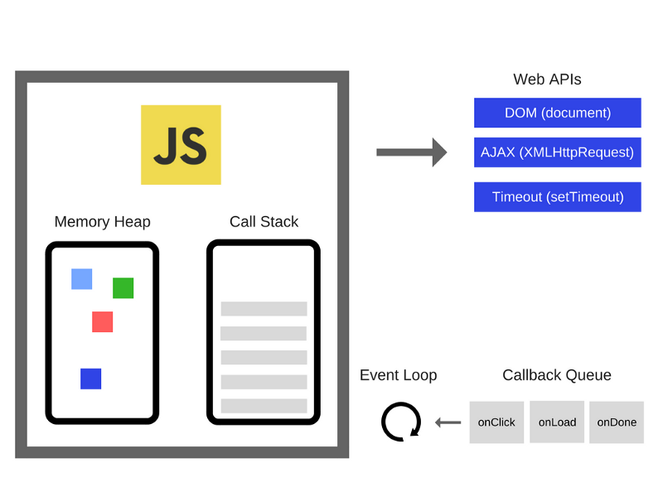
JavaScript Engines Implement
Javascript 引擎实现一个调用堆栈和内存堆

Slide 3
Understanding

Slide 4
Event Loop
“事件循环”这个名字来源于它往往这样来实现：
while (queue.waitForMessage()) { queue.processNextMessage();
}
如果当前没有message, queue.waitForMessage()这个方法会同步地一直等待
这个模型的优势在于它必须处理完一个消息(run to completion),才会处理下一个消息,使程序可追溯性更强。不像C语言可能随时从一个线程切换到另一个线程。但是缺点也在于此,若同步代码阻塞则会影响用户交互

Slide 5
Event Loop
Event Loop Model never blocking
Javascript, unlike a lot of other languages, never blocks. Handling I/O is typically performed via events and callbacks, so when the application is waiting for an IndexedDB query to return or an XHR request to return, it can still process oter things like user input

Slide 6
Call Stack

Slide 7
Dissecting the Event Loop
Until ES6, Javascript itself has actually never had any direct notion of asynchrony built into it
WebAPIs, in essence, they are threads that you can't access, you can just make calls to them. They are the pieces of the browser in which concurrency kicks in. In Node.js, these are the C++ APIs
After all, the event loop has one simple job--to monitor the Call Stack and the Callback Queue. If the Call Stack is empty, it will take the first event from the queue and will push it to the Call Stack, which effectively runs it.

Slide 8
Tick

Slide 9
ES6 Job Queue
It's a layer on top of the Event Loop queue.
You are most likely to bump into it when dealing with the asynchronous behavior of Promises.
The Job Queue is a queue that's attached to the end of every tick in the Event Loop queue
Certain async actions that may occur during a tick of the event loop will not cause a whole new event to be added to the event loop queue, but will instead add an item(aka Job) to the end of the current tick's Job queue(完整的Event Loop 的理解)

Slide 10
Promise
p instanceof Promise?
async/await makes the job of working with Promises easier

Slide 11
来自亮哥的一段代码
new Promise((resolve, reject) => {
resolve(1);
Promise.resolve().then(() => console.log(2));
console.log(4);
}).then(val => console.log(val));
console.log(3);
//4 3 2 1

Slide 12
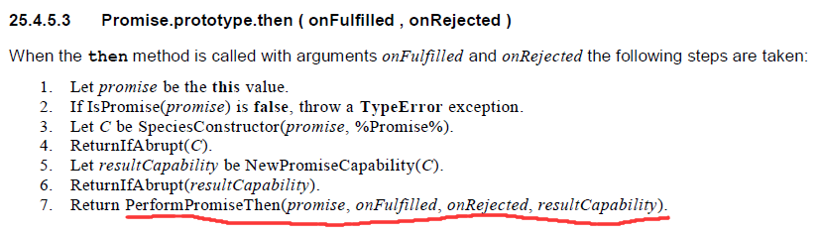
Key
Promise的then中的callback在执行到then的时候才会压入Job Queue --ECMAScript-262

Slide 13
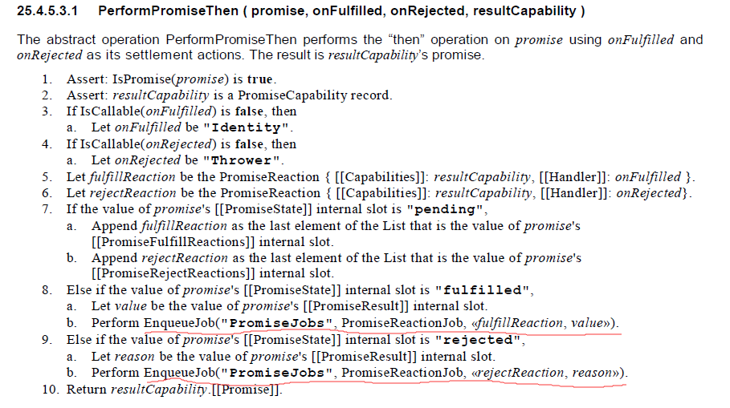
Key

Slide 14
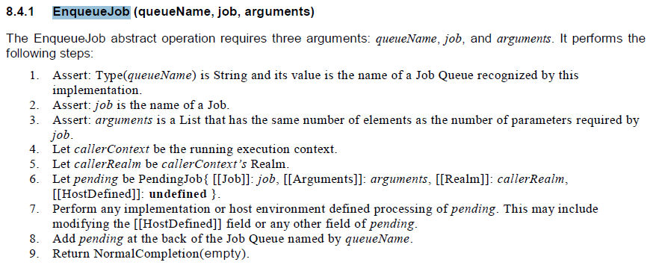
Key

Slide 15
References
[1]. Concurrency model and Event Loop -- Wiki (https://developer.mozilla.org/en-US/docs/Web/JavaScript/EventLoop#Event_loop)
[2].tasks,microtasks,queues and schedules
(https://jakearchibald.com/2015/tasks-microtasks-queues-and-schedules/)

